Slide 1
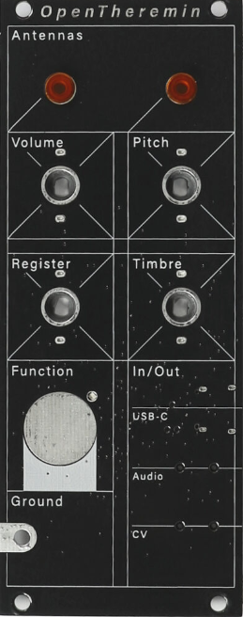
OpenTheremin V4
Legato / Pitch Bend Mode
Pitch Bend Range
Legato Off
Pitch Bend On
Legato On
Pitch Bend Off
5
7
https://www.gaudi.ch/OpenTheremin/
4
12
Legato Off
Pitch Bend Off
Legato On
Pitch Bend On
2
24
1
48
Play
VALUE
VALUE
Mute
MIDI Channel
Trigger Volume / Velocity
8
9
6
7
9
10
11
Continuous adjustment of Trigger Volume threshold and Velocity sensitivity
5
12
4
13
3
14
2
1
15
Turn to max to disable Note and Pitch Bend messages
(only CC will be sent)
VALUE
16
VALUE
PARAMETER
VALUE
Timbre
Rod MIDI CC
4
5
6
(14 Bits Res. ) 16-48
17-49 (14 Bits Res. )
3
Pan 10
18 (7 Bits Res.)
2
7
Balance 08
19 (7 Bits Res.)
1
8
None
74 Cutoff
VALUE
VALUE
CC 16 to 19 are General Purpose controllers
Register
Loop MIDI CC
Center
Resonance 71
74 Cutoff
PARAMETER
Expression 11
91 Reverb
Off
Volume 07
93 Chorus
Pink
-1 Octave
+1 Octave
Modulation 01
95 Phaser
VALUE
VALUE
D
E
F
Step 1: Select a Parameter
Step 2: Adjust its Value
MIDI Configuration
C
B
G
A
H
https://github.com/MrDham/OpenTheremin_V4_with_MIDI

